Slide 1
Immunization
Sebastian Ungard

Slide 2

Goals of Immunization Strategies
When an individual becomes vaccinated, not only are they protected, but they help slow down the spreading rate.
Determine the best targets for vaccination to slow down the spreading
Maximize the effectiveness of a single vaccine

Slide 3
Random Immunization
Randomly select individuals in the population to vaccinate
Simple to set-up and execute
Would not discriminate against any subset of the population
Random immunization requires a large percentage of the population to be effective, meaning it takes valuable time and resources.
Can be improved quite easily!

Slide 4
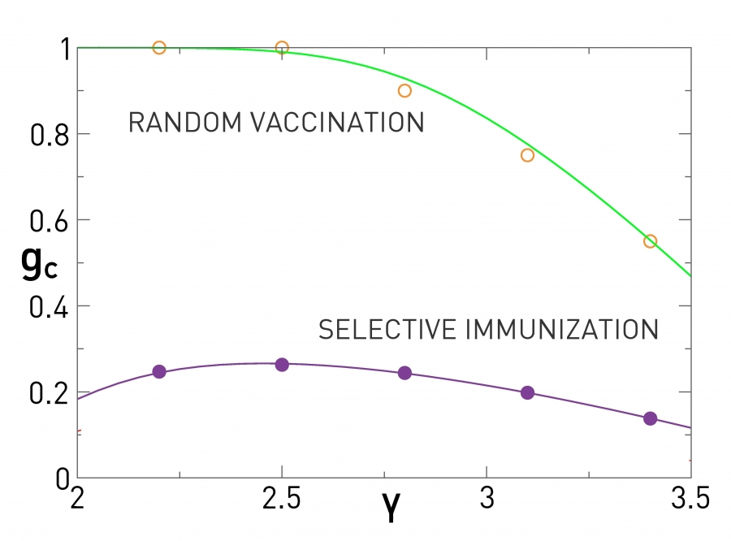
Using Neighbors
How it works:
Select a random individual from a population.
Ask said individual to list most ‘popular’ neighbor.
Vaccinate that neighbor.
This strategy targets hubs in a population and can be repeated for even better results.
G_{c} is lower for all levels of y using the neighbor strategy.
(y is the degree exponent in scale-free network generation)

Slide 5
Strategies for Modular networks

Slide 6
Community Bridge Finder
Goal is to find and vaccinate the nodes that act as bridges between different communities.
Algorithm is a Stochastic strategy.
Assumes that the network has non-overlapping communities.
Best in networks with strong community structures.
Algorithm:
Select random node v_{i = 0}
Follow random walk where each new node has not yet been visited.
For each node v_{i >= 2}, check if connected to more than one previous node. If just one connection, v_{i - 1} is a potential bridge.
Select two neighbors of v_{i} other than v_{i - 1}. If these have no connection to previous nodes then v_{i - 1} is a bridge. Otherwise random walk from v_{i - 1}.

Slide 7
Random-Walk Overlap Selection
While not all overlapping node has a high centrality, they still can be major spreaders. This algorithm is designed to target highly-connected overlapping nodes for immunization.
Algorithm is a Stochastic strategy.
Assumes that the network has overlapping communities.
Algorithm:
Define the list of overlapping nodes.
Select a random node from the network and run a random walk.
If a node in the list of overlapping nodes is visited it is nominated for immunization.

Slide 8
Boundary Vicinity Algorithm
This algorithm finds and ranks the nodes closest to the ‘border’ of a community.
Algorithm is a Deterministic strategy
Assumes that the network has non-overlapping communities.
Helps protect a community from outside threats.
Algorithm:
Define the set of communities of the network.
Extract the set of bridges which connects communities.
Run a number of random walkers of a chosen fixed number of steps from each bridge node. Count the number of visits to each node in a community.
The most visited nodes are nominated to vaccination

Slide 9
Deterministic methods with Overlapping Communities
Because we already know the details of the network, we do not need to apply any algorithms for these methods.
Membership strategy
  Rank nodes by the number of communities they are a part of.
OverlapNeighborhood strategy
  Select immediate neighbors of overlapping nodes as top spreaders.

Slide 10

Findings
The best immunization strategy for a network often depends on the strength of the communities within the network.
Deterministic strategies almost always outperform non-deterministic ones.
Stochastic strategies improve in efficiency the more data is given at the start.

Slide 11
Conclusions and Personal Thoughts
These algorithms propose methods that work great in relatively small scale environments. They could be used in these situations to maximise their vaccine usage.
While these algorithms greatly improve the effectiveness of vaccinating individuals in a network, it is still extremely difficult to apply in the real world.
Real world networks can be extremely convoluted.
Can be hard to gather data on each individual in the network.
People nominated by the algorithms for immunization may refuse.

Slide 12
Questions?

Slide 13
References
Hocine Cherifi, Gergely Palla, Boleslaw K. Szymanski, Xiaoyan Lu. On community structure in complex networks: challenges and opportunities. November 5, 2019. https://arxiv.org/pdf/1908.04901.pdf
Barabási, Albert-László. “Network Science.” 2018, networksciencebook.com.
Images:
https://clipart.world/magnifying-glass-clipart/icon-magnifying-glass-clipart-transparent/
https://www.wilsonhealth.org/news/now-offering-online-scheduling-covid-19-vaccinations

